Slide 1
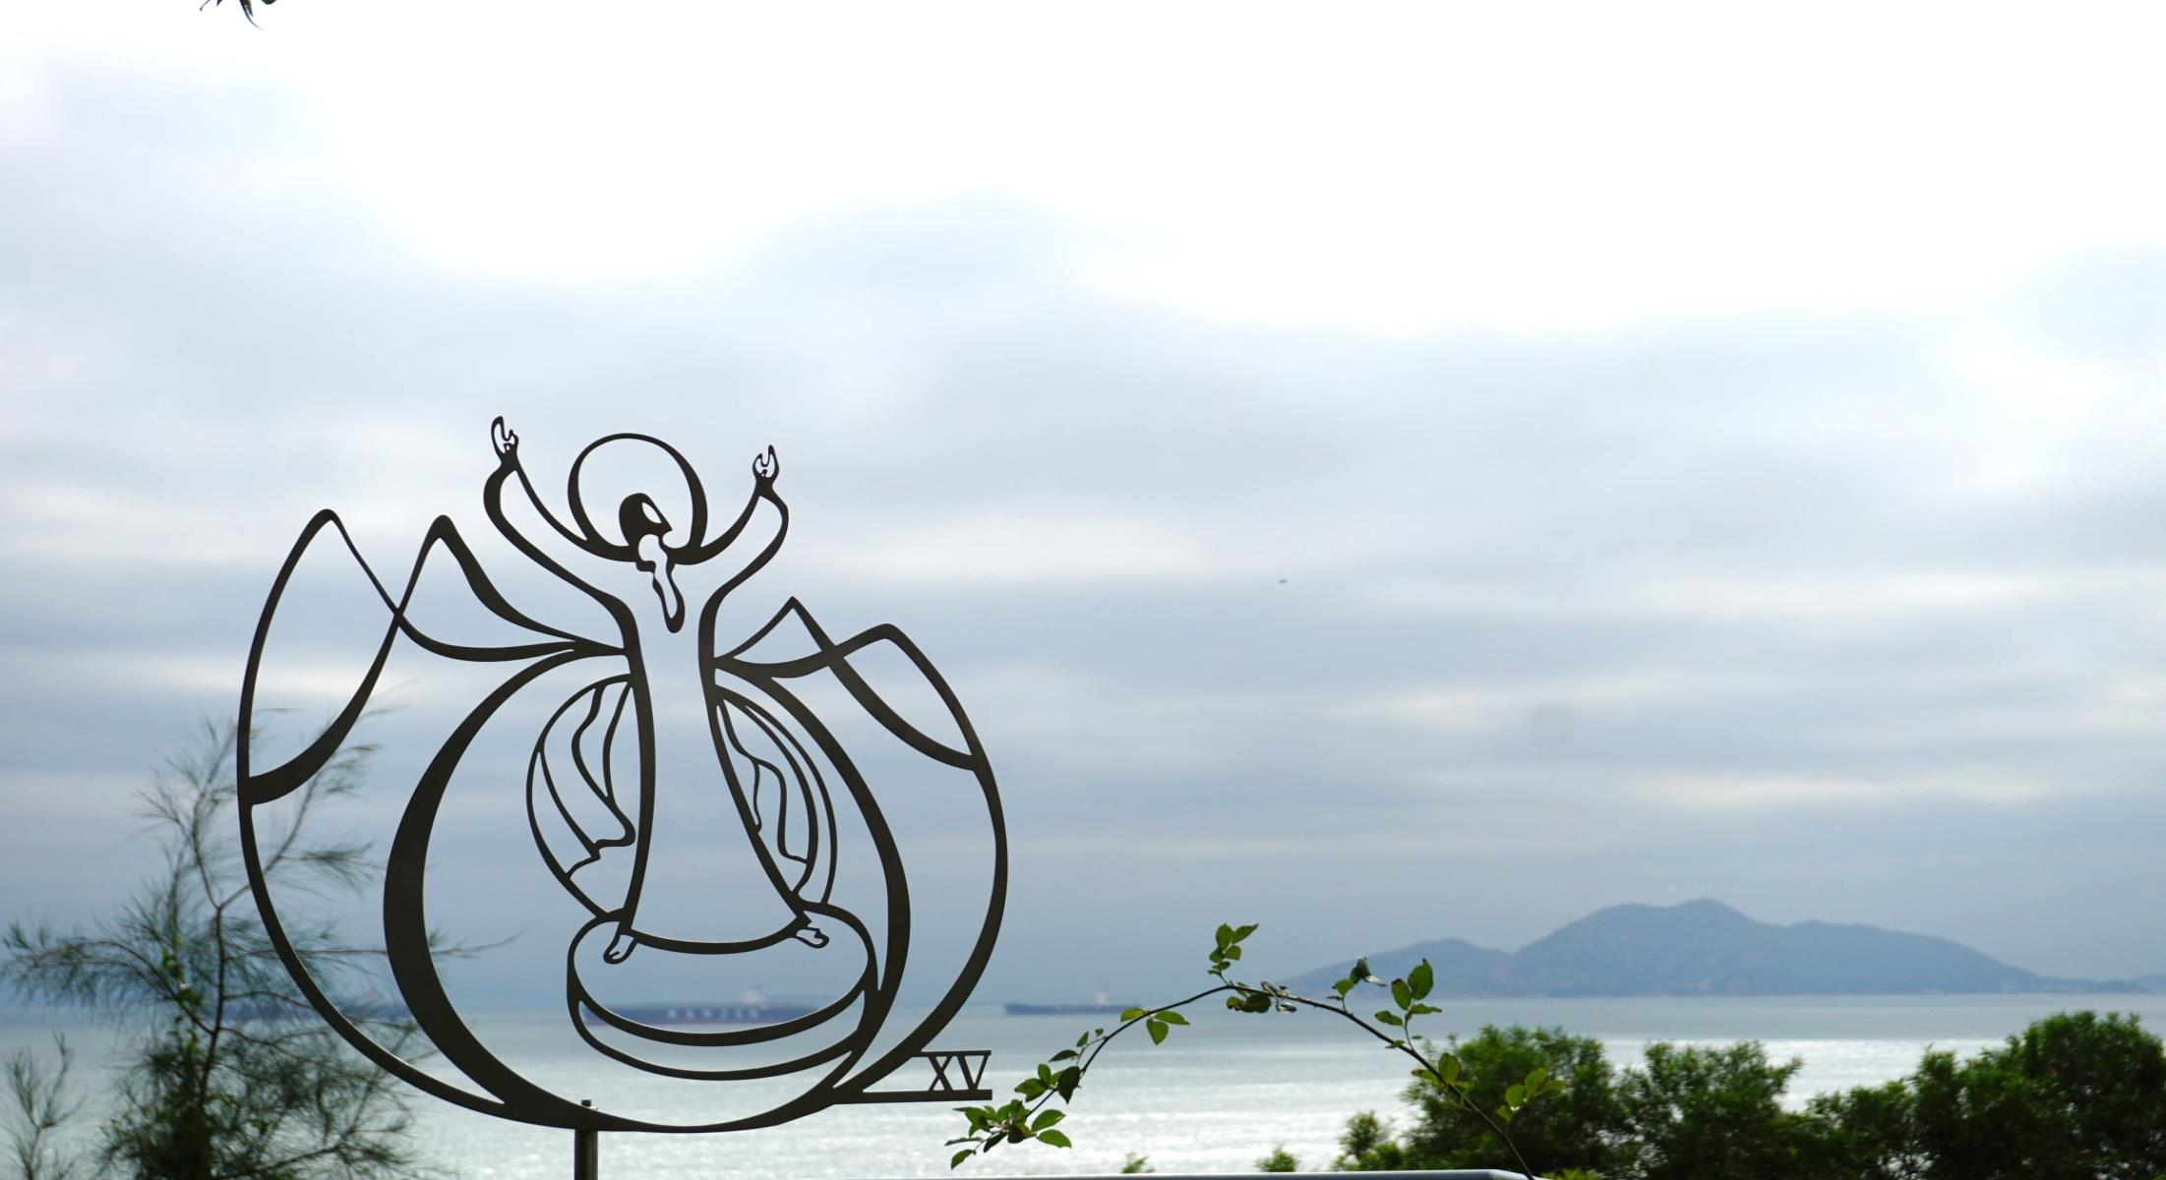
A Response to Fr. Whelan’s Presentation on Lonergan’s Idea of Reconciliation
Stephen Tong, S.J.
Oct 22, 2019

Slide 2
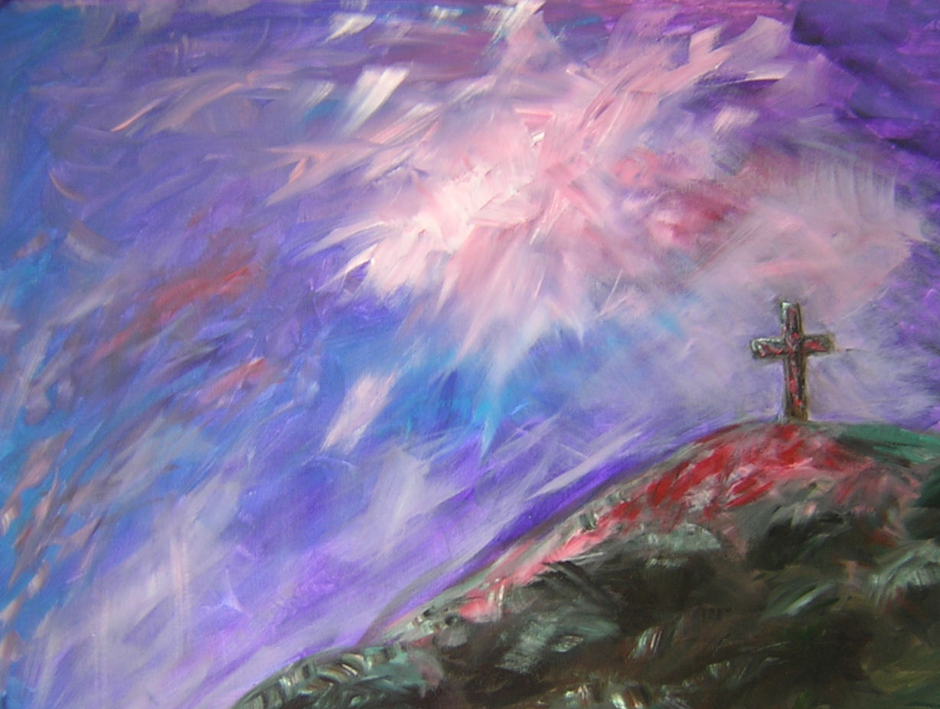
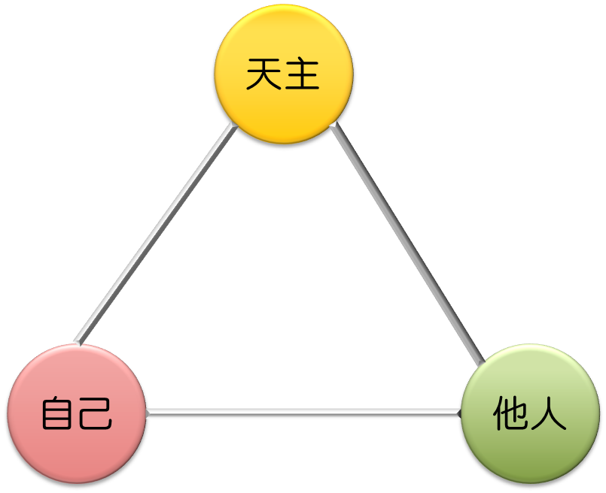
愛
Fr. Whelan’s sharing was very rich.
My focus is mainly on
Reconciliation with Oneself from a Lonergan’s & Ignatian Viewpoint

Slide 3
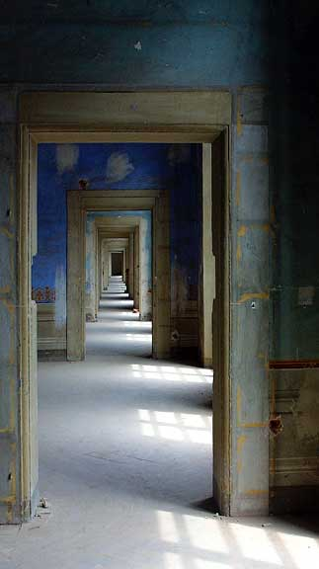
The Conditions of this Reconciliation
向內走
(One’s Interiority)
學會注視內心的動態，意識到自己內心的真實
(Attentive to it)
包括我們喜歡的部份和我們不願意面對的部分
(Positive & Negative)
Notes:
Holding and encouraging retreatant to contemplate the parts that one does not like.

Slide 4
A SD Experience
A sharing of one’s inner happenings
He seems to be in a joyful mood when reporting
“Have to…”
“Overwhelming religious languages..”
My own discomfort and suspicion

Slide 5
A SD Experience
Invite him to see the feeling behind what he says.
Engage with further conversation and mutual exploration.

Slide 6
A recent SD Experience
留意(Being Attentive)
有距離的連繫 (Create a Connected Distance)
停留、默觀 (Stay and Contemplating)
描述、命名 (Descripting and Naming)
Notes:
當受輔者有一些難以碰觸的情感，如童年創傷等：
May fluctuate between two extremes:
Cut off, run away or numb
Overwhelm by the emotion
SD can help the retreatant by helping to stay at a connected distance

Slide 7
Operation of Consciousness
價值滿全
D (decision)
條件滿全
J (judgment)
決定
U (understanding)
判斷
價值
提問
E (experience)
明瞭
反思
提問
經驗
明智
提問
注意
發現
觀察
外感官
內感官
Contemplating One’s Interiority in a Conversational Context
A basic description and external revelation
The interiority elicited in the counterpart
Mutual revelation & conversation
From external to internal to deeper dimension
From aware movement to the unaware
From isolated movements to a regular pattern
From intellectual knowing to affective insight
Mutually providing evidences to confirm or deny the discoveries or understanding.
The affirmed discoveries can be the path towards conversion or reconciliation
要求/
恩寵
專注
接納
靜、慢
Be attentive
困難/
陷阱
壓抑
忽略
否認
不敢接受
Notes:
Shall I take out the SD self-contemplation and develop a separate EUJD on self?

Slide 8
General Empirical Method (GEM)
It renders the success of science since 17th Century.
The Operation of our consciousness is empirical as well.
It creates an ongoing and explorative dynamics leading to cumulative results
The interaction between nature and grace
Notes:
Compared to the Revolution of Science, all other events like reformation, two world wars are reduced to mere episodes.
You can catch yourself in doing which operation

Slide 9
Conclusion
The problem of the others in contemporary concerns.
The GEM provides a solid path to engage in this concern
It is also a way of being the Church & doing Theology
Notes:
Holding and encouraging retreatant to contemplate the parts that one does not like.

